Slide 1

Credit Intelligent Advisor
TA Geoffrey

Slide 2

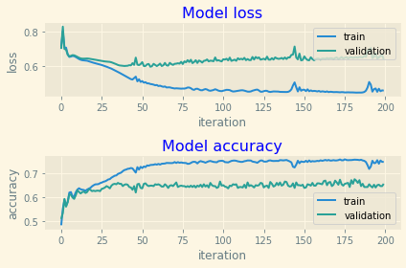
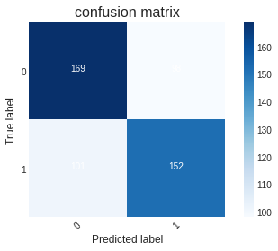
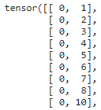
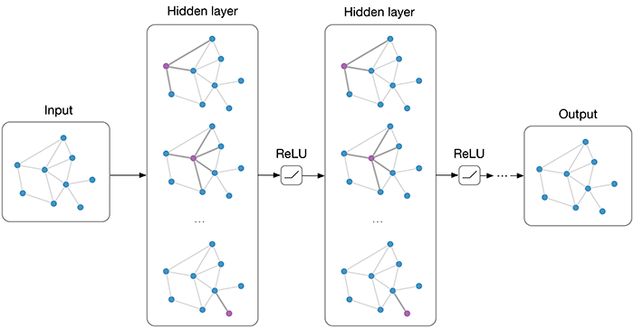
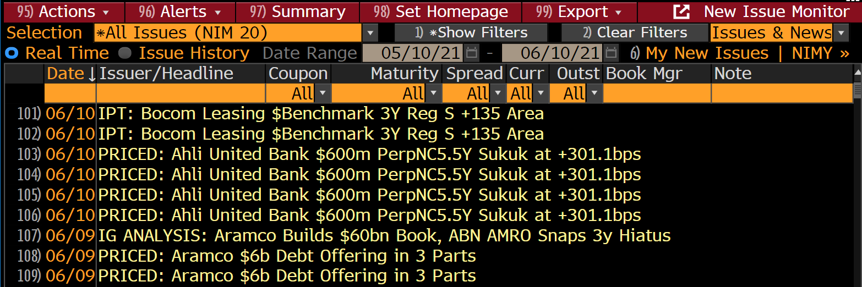
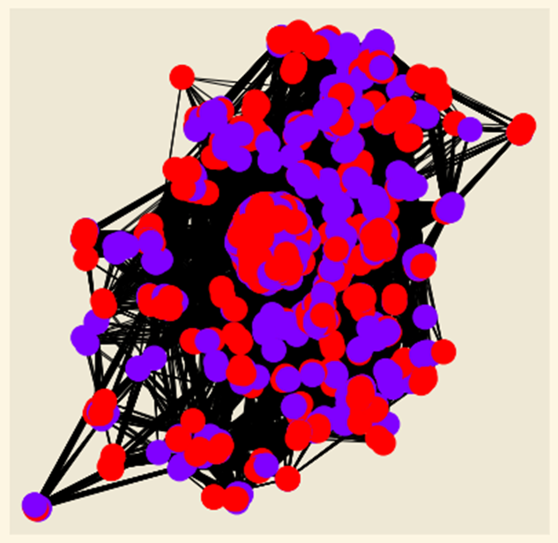
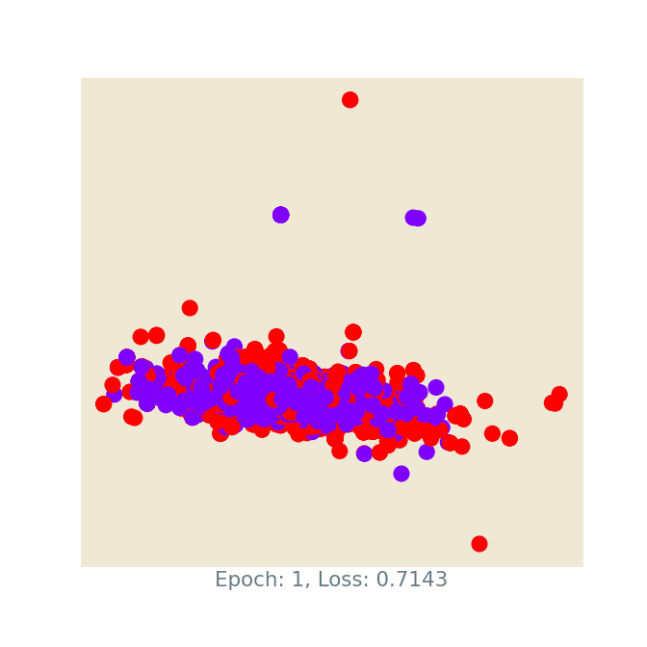

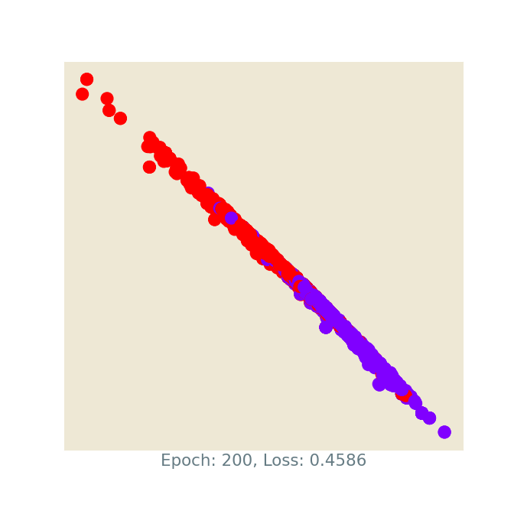
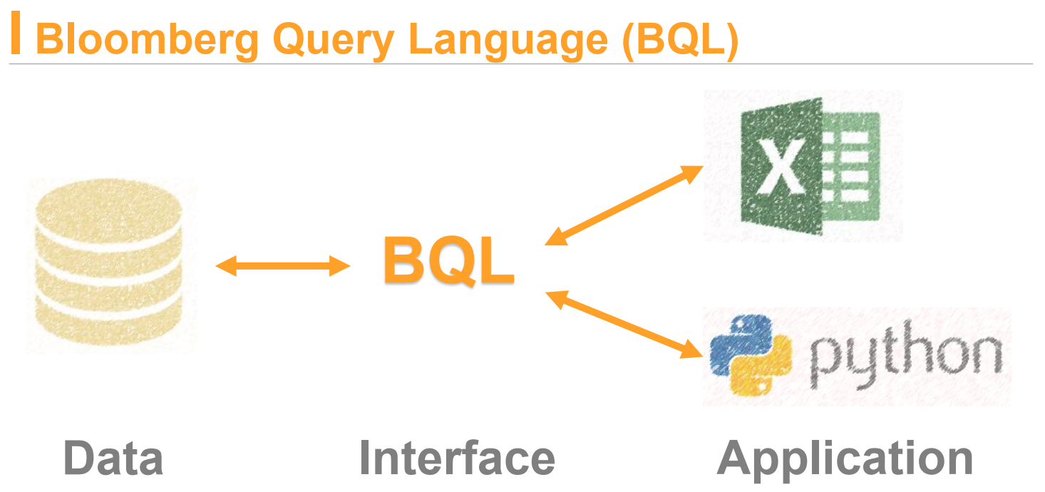
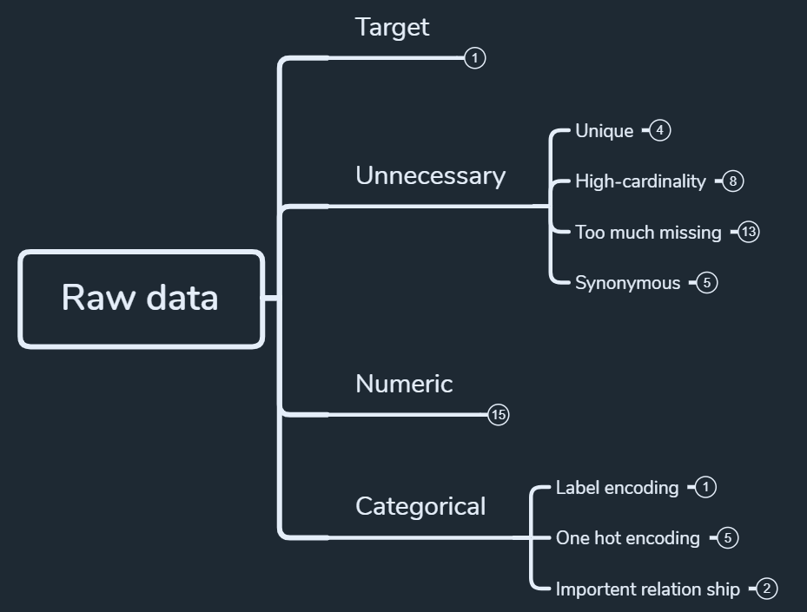

Credit Intelligent Advisor Snapshot
Geoffrey Chin
Introduction
Methodology and Results
Discussion and Conclusion
Credit bond market has long been considered illiquid and non-transparent.
Predicting the market performance of individual new issue bond, which has the most liquidity in its life-cycle.
I aim to predict market performance using fundamental & technical data as features to capture opportunities of capital gains. For example, when traders do not have strong view towards specific issuance, model can help them create undiscovered return.
I use Graph Convolutional Networks(GCN) as the model.
I select “Issuer” and “Industry” to construct the graph, every node is a data point, in COO format, [0, 1] means node 0 has same issuer or industry with node 2.
I got 74.96% train accuracy and 66.28% test accuracy
Graph Convolutional Networks(GCN
From Confusion Matrix we can count out F1-score is 0.6456
Future Work
Include more features to neural network, such as bid/cover ratio, ESG scores, and news sentiment, etc.
Using neutral network to predict longer period of bond performance.
Dataset
After constructing the graph, using datasets to train the model
The datasets used in the project (market & individual company data) were directly pulled out from Bloomberg Terminal.
Currently collected data ranges from 2012 to 2021 period.
The model is currently running on Google Colab, in the future I will switch to Bloomberg BQNT Platform.
References
[1] https://pytorch-geometric.readthedocs.io/
[2] https://github.com/rusty1s/pytorch_geometric/tree/master/examples
[3] https://peaceful0907.medium.com/
[4] https://www.youtube.com/watch?v=WeHM2xpYQpw
Classification Model
Classification Model results from higher-dimensional space project to 2D space

Slide 3



How it works
Model
Positive Probability > 0.7 Negative Probability < 0.3
Positive Probability < 0.3 Negative Probability > 0.7
Input feature data
Place Order
A new issue announcement coming
Sideline
By inputting the features, the model will predict whether the new issue bond will have all-in price performance better than median (currently 0.62) in 1 month.

Slide 4
Machine
Learning

Slide 5
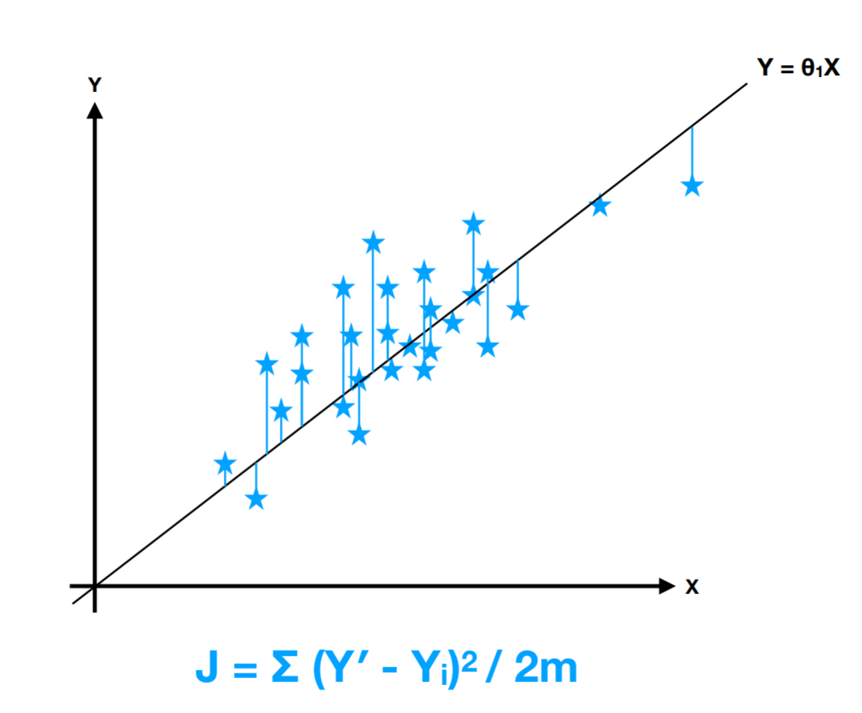
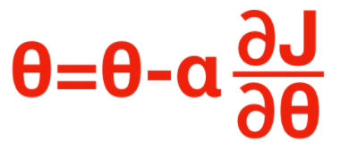
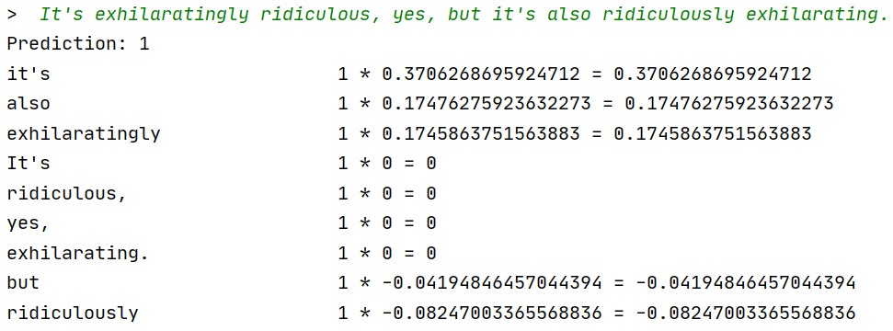

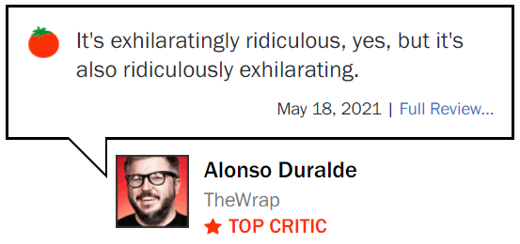
What is machine learning?
Ø is the weight
X is the feature
By finding the best fitting Ø, we can have a model to predict the outcome when giving feature.

Slide 6
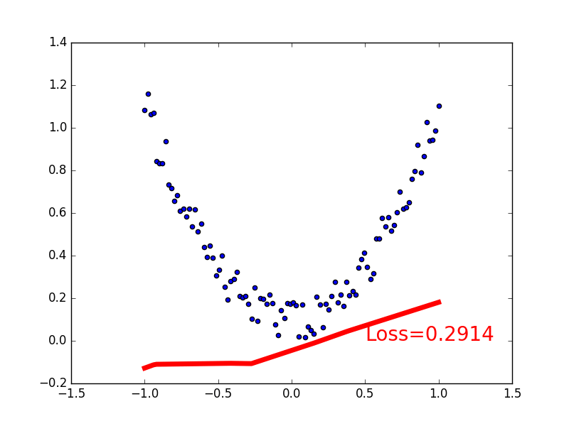
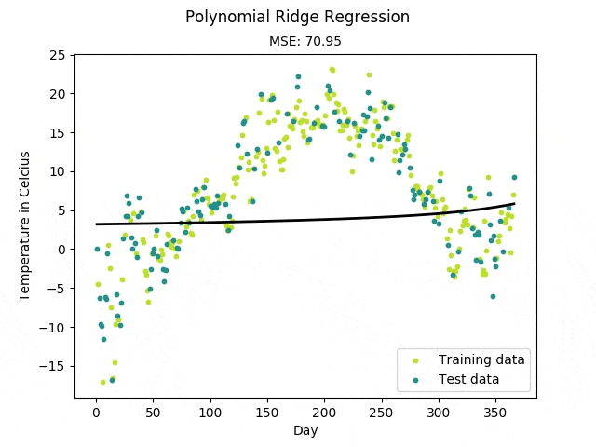
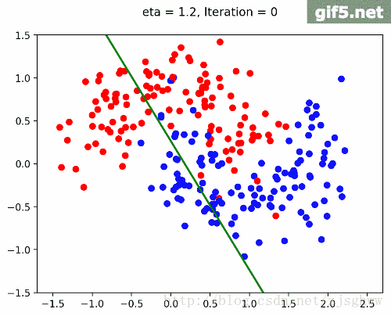
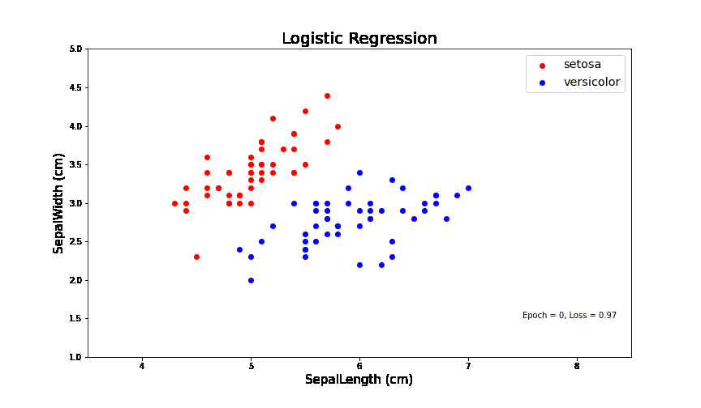
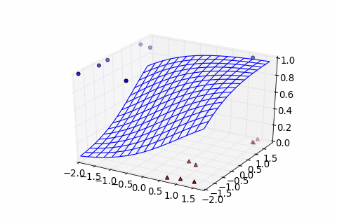
Extension of machine learning

Slide 7
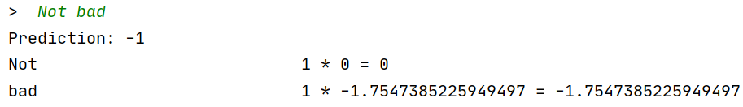

The problem of machine learning

Slide 8
Deep
Learning

Slide 9
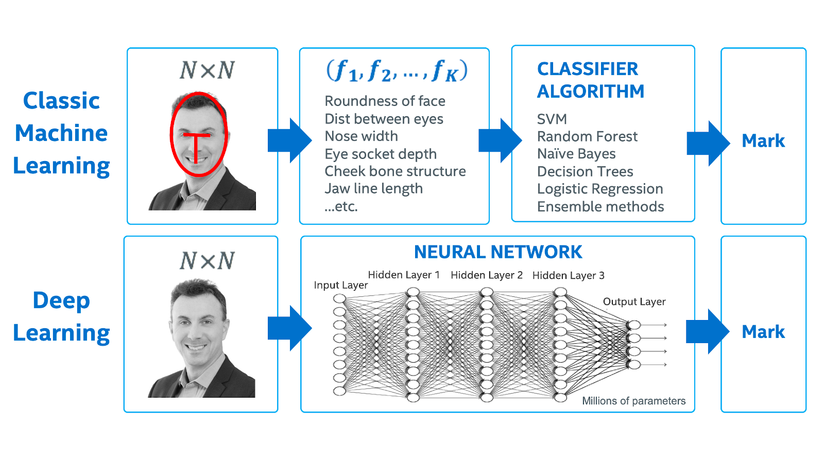
How it works

Slide 10
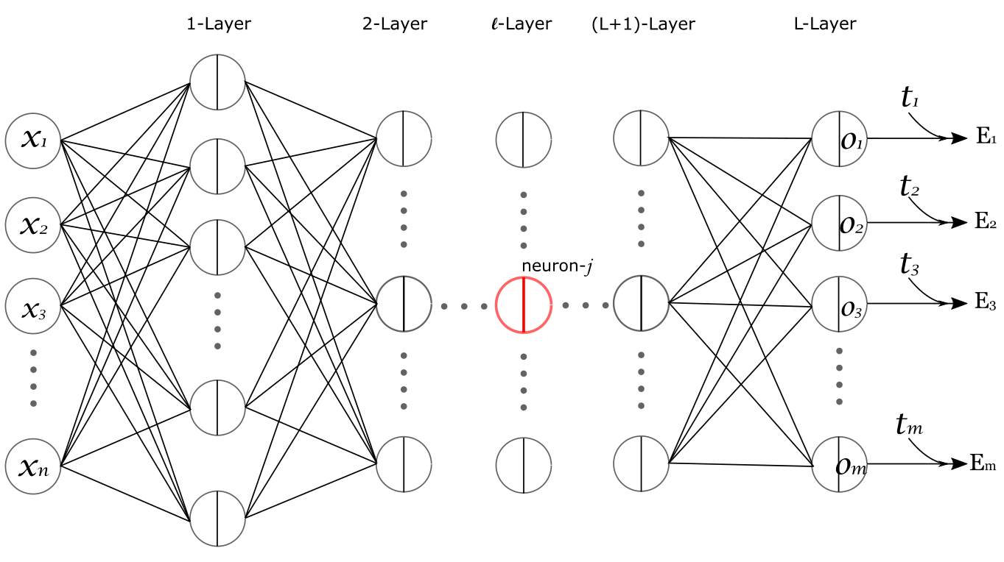
How it works

Slide 11
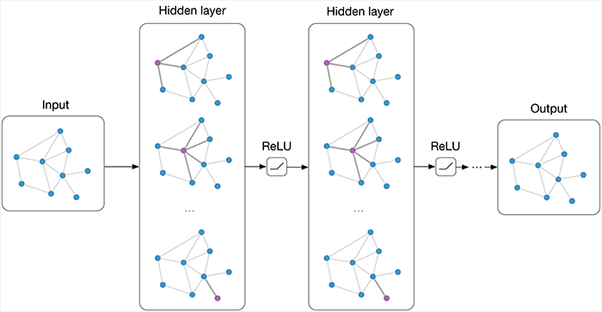
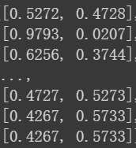
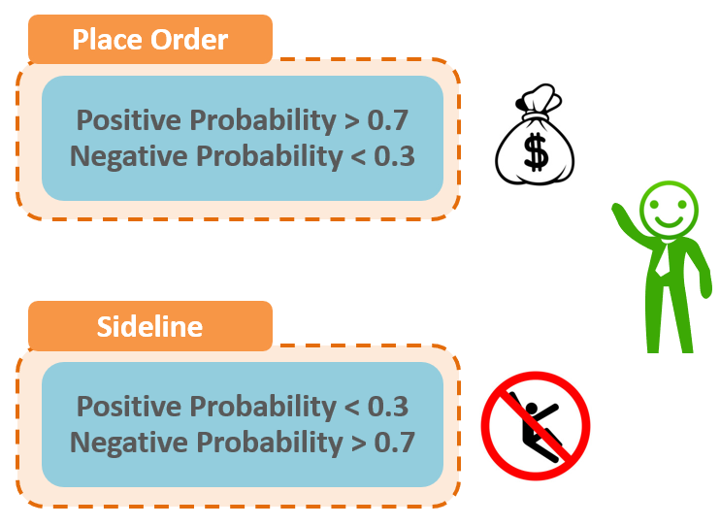
Credit Intelligent Advisor
Neg prob, Pos prob
Pos/Neg prob is the confidence level of the model, the higher the number, the more the confidence the model has on the new issue.

Slide 12
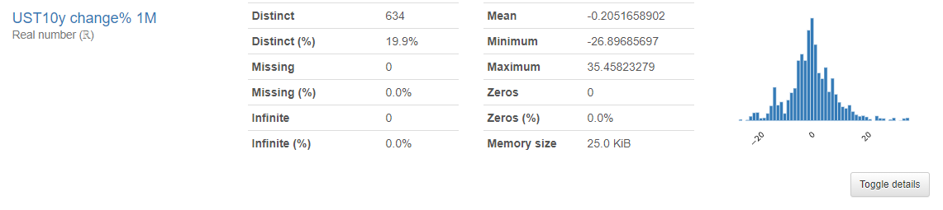
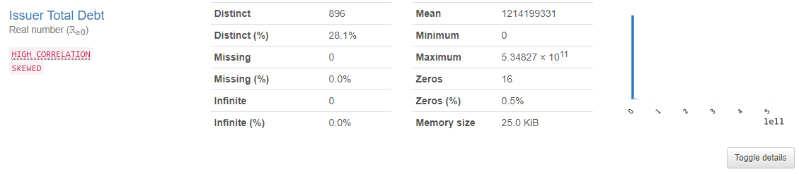

6 simple steps to Credit Intelligent Advisor
Step1: Collect Data
Step2: Analyze Data
Step3: Organize Data
Step6: Make Decision
Step5: Train Model
Step4: Build Model

Slide 13
Step 1. Collect Data - Datasets
Use BQL function to gather IG new issue data from 2012-2021 Currently have 6,929 raw data

Slide 14
Feature Characteristic
Issuer Avg Coupon BBG
1M DXY chg% 3M
Use of Proceeds
Tenor
Composite Rating
IG Total Sector
SPX change% 1M
Cash Ratio
Issue Amount
EBITDA to Interest Expense
Years to Maturity at Issue
Sector
Issuer Debt Due <12M
EBITDA Margin
Country
UST10y change% 1M
1M GS Financial condition
Issuer
GS Financial condition chg%
Issuer Num Issues
Net Debt/EBITDA
Coupon Type
1M Commodity Index chg%
Market of Issue
Sales Growth YoY
Issuer Debt Avg Maturity
CDX IG 5Y
Issuer Total Debt
Industry
Payment Rank
Num Leads
IG Total Sector chg 1M
Region
Bond Type
CDX IG 5Y %
Maturity

Slide 15
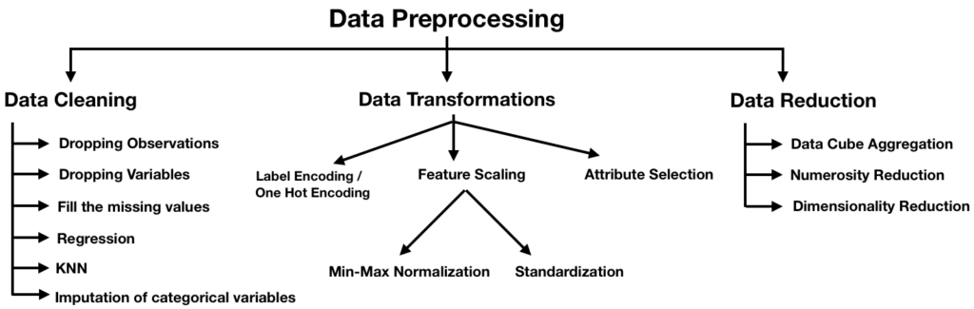
Step 2. Analyze Data

Slide 16
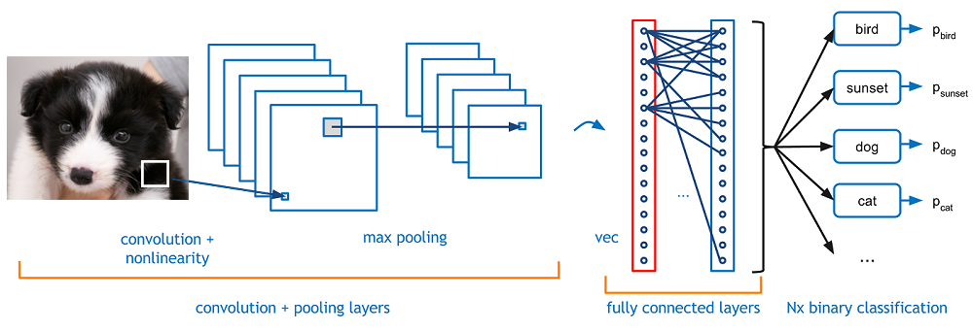
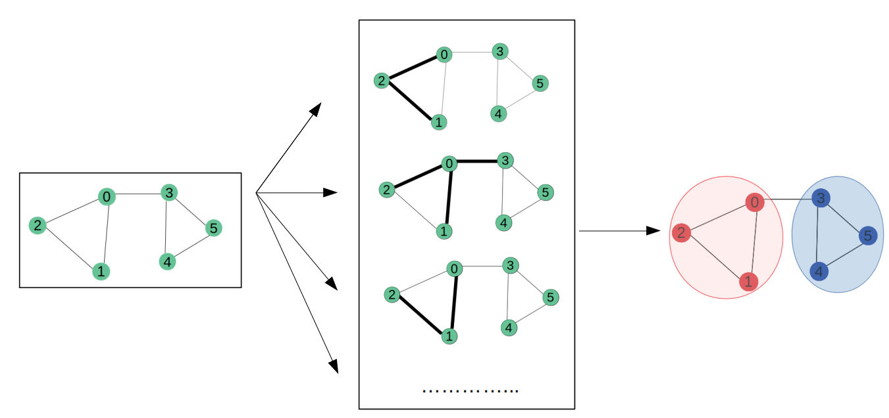
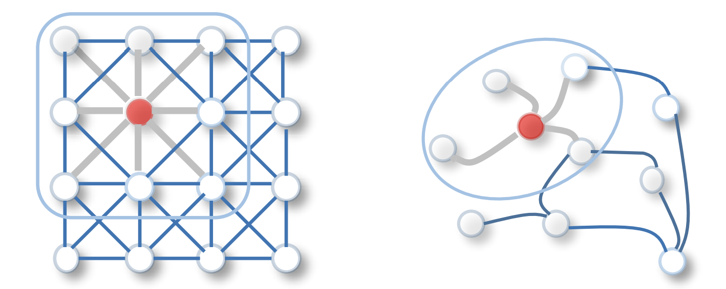
Step 3. Organize Data – Using GCN Model
Convolutional Neural Network (CNN)
Graph Convolutional Networks (GCN)

Slide 17
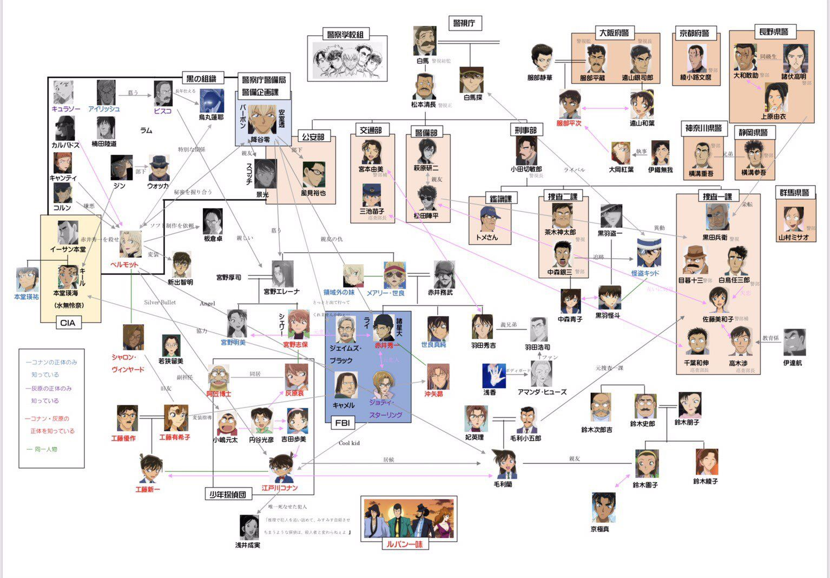
Step 3. Organize Data – What is Graph

Slide 18
Step 3. Organize Data – Build our GCN Model
1. Use Issuer & Industry as connections to build network
2. Use the network to train our model
3. Classify the result

Slide 19
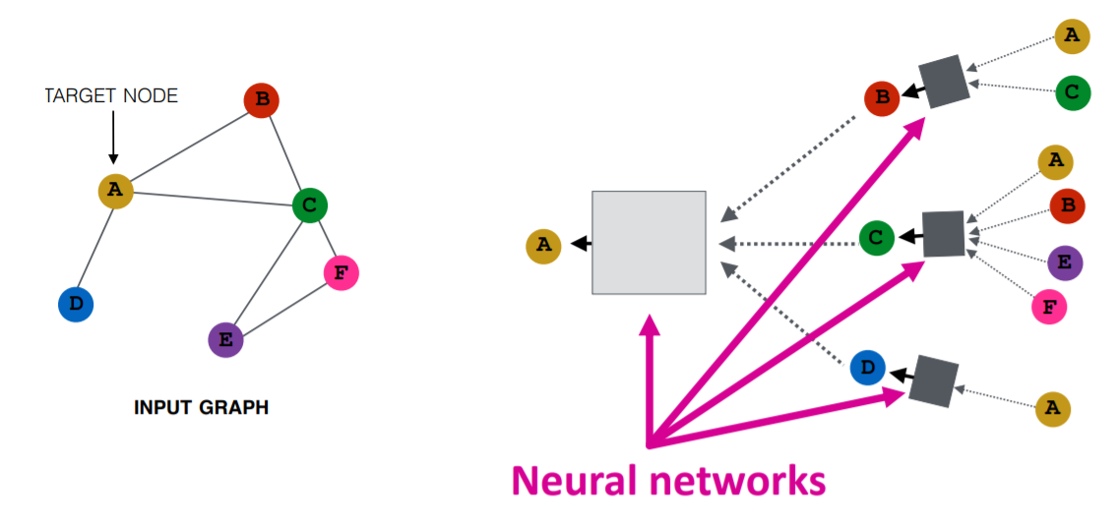
Step 4. Build Model – Using GCN Model
GCN nodes pass message through connecting nodes

Slide 20
Step 5. Train Model
Red dot is True Positive, Purple dot is True Negative
Y axis: Positive
Y axis: Positive
X axis: Negative
X axis : Negative
65.70% validation accuracy
66.28% test accuracy

Slide 21
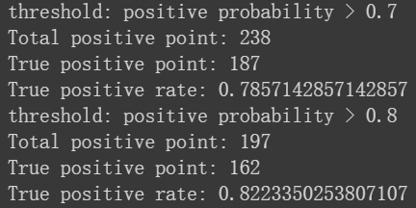
Step 6. Make Decision – Model Result
Neg prob, Pos prob
For Pos prob >0.7
Model Thinks Positive
Real Positive
Pos prob
78.57% Accuracy!

Slide 22
Step 6. Make Decision – To bid or not to bid
Model
Positive Probability > 0.7 Negative Probability < 0.3
Positive Probability < 0.3 Negative Probability > 0.7
Place Order
Neg prob, Pos prob
Sideline
Current Median is 0.62

Slide 23
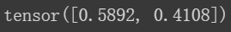

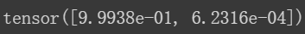
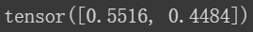
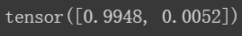
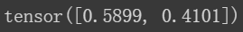
What if we had this model last year… (1/2)
Name | Amt | price change 1M | Model Output | Prediction Result
AZN 0.7 04/08/26 | 15 | -0.1374 | 963
CVX 1.018 08/12/27 | 3 | 0.0824 | 937
CMCSA 1 1/2 02/15/31 | 10 | -0.4420 | 922
NESNVX 0 5/8 01/15/26 | 20 | -0.4936 | 842
NESNVX 1 09/15/27 | 15.5 | -0.0064 | 836
HYNMTR 1.8 01/10/28 | 5 | -0.6550
Above is the existing credit bonds in our OCI portfolio that we purchased through new issue market last year (HYNMTR is from this year)
If we had the model last year, we could avoid $194,800 loss in 1M !!!

Slide 24
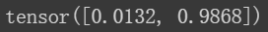
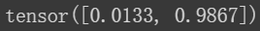
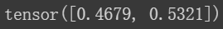
What if we had this model last year… (2/2)
Name | price change 1M | Model Output | Prediction Result
MEITUA 3.05 10/28/30 | 2.2324
MEITUA 2 1/8 10/28/25 | 1.0025
LENOVO 3.421 11/02/30 | 6.2811
Above is the credit bonds that we missed to buy last year in the new issue market.
If we had the model last year, we could have an average
$31,720 gain per 1 MM in 1M for new issue above !!!

Slide 25
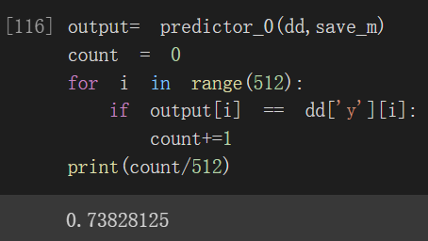
What if we had this model this year…
To test if the Model is solid
I edit the training data to range from 2012 to 2020.12.31
And put real new issue data of 2021 into testing and…
dd is our data feature
Including 2021 data
Output is the model prediction
save_m is our trained model based on 2012-2020 data
73.83% Accuracy for 2021!

Slide 26
Application of the model: Increase both clients’ and ours profit
Trading
Funding
Sales

Slide 27
Thank You
For Your Attention
And the trouble is, if you don't risk anything, you risk even more.

Slide 28

Appendix

Slide 29
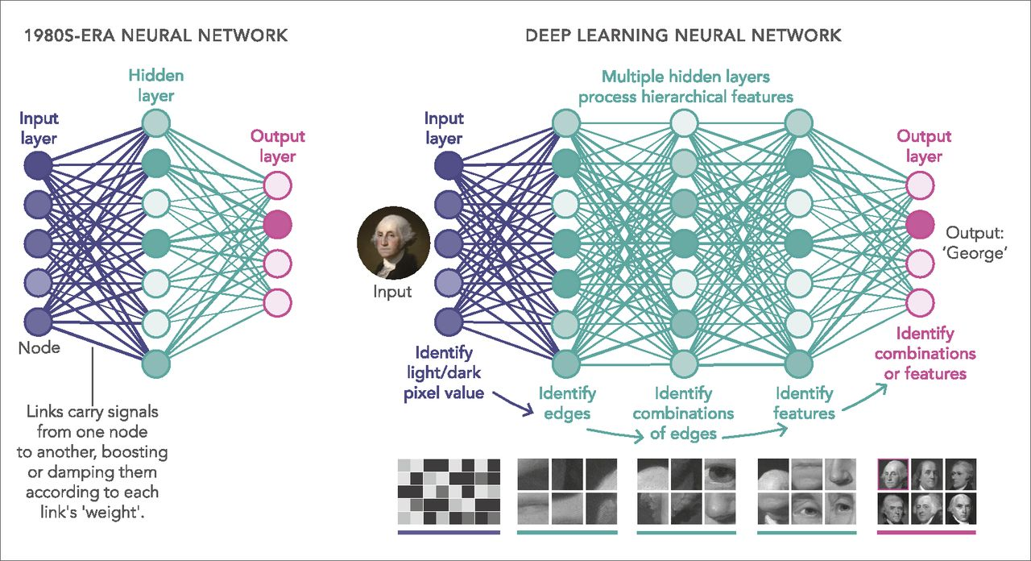
Neural Network

Slide 30

Different Optimizer

Slide 31
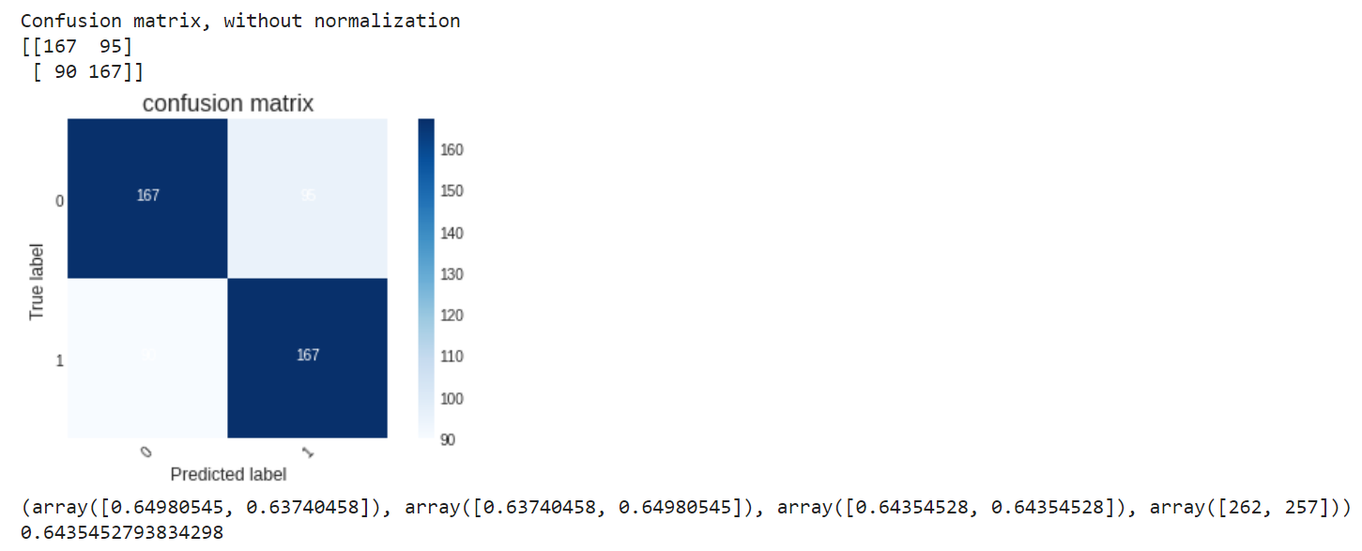
Confusion Matrix Result

Slide 32
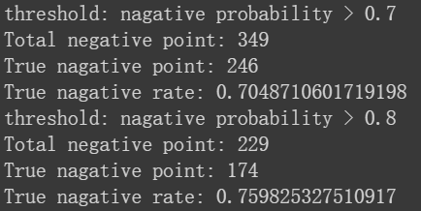
Credit Intelligent Advisor
Neg prob, Pos prob
Neg prob
Pos prob

